Slide 1
PySolo Tracking
Goal: Find the units of the numbers produced by PySolo Acquire.
Methods
Identify distance calculations in Acquire.
Manually calculate distance fly moves over first 10 frames of the video.
Results
There are two functions in Acquire that calculate distance.
They are found in pysolovideo.py and called “calculateDistances” and “AddFlyCoords”.
These functions use different coordinates for the fly and produce different results.
The result may be compatible.
One of these functions produces the results that are reported by Acquire.
There are functions for calibration and conversion to cm measurements, but they seem to be unused.
I am unfamiliar with tracking processes, but chose two possible methods to calculate distance moved.
Select center of fly in each frame. Calculate distance between center points from frame to frame.
Using image created by subtracting one slide from the next, calculated length of region where images were different.
None of these four methods produced the same results (see slide 4).
Next Step:
Decide what method of calculation is desired and alter Acquire to use that method.
I may need help with programming regarding tracking methods.
Or don’t worry too much about the numbers and consider only if fly has moved or not moved.

Slide 2
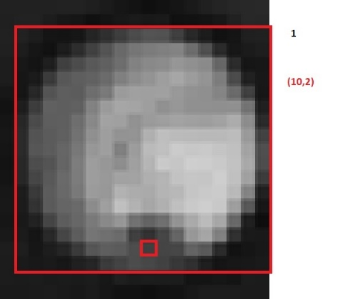
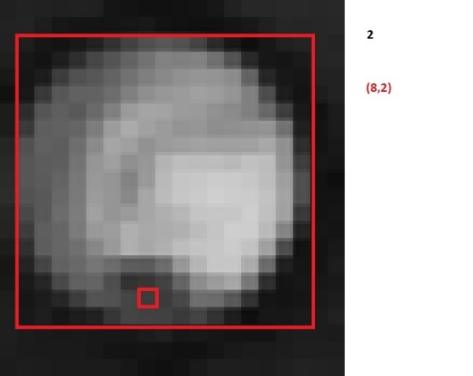
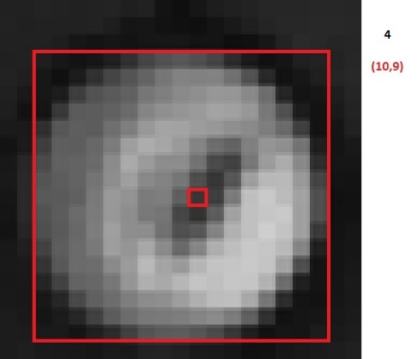
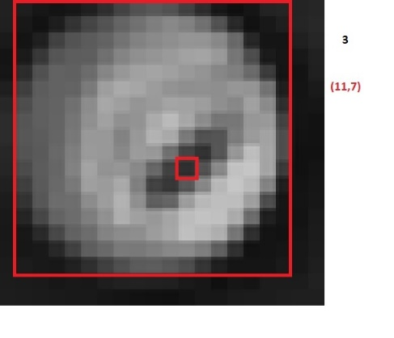
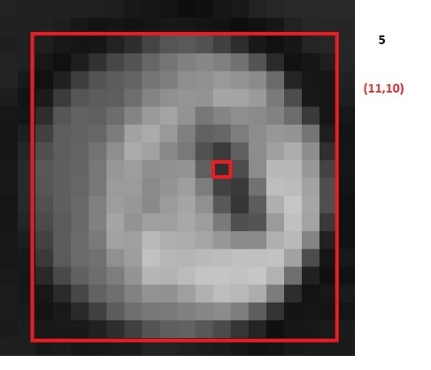
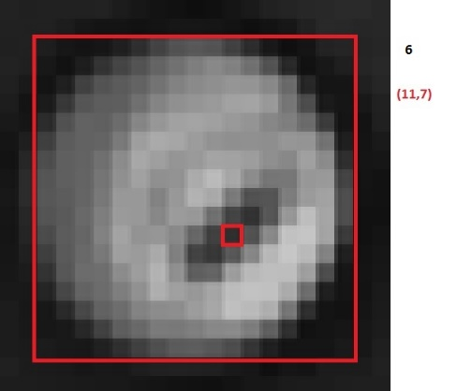
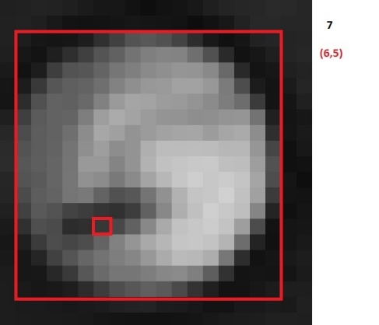
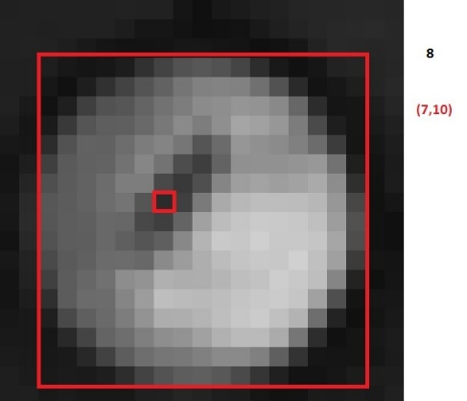
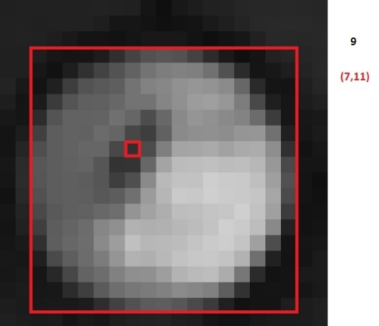
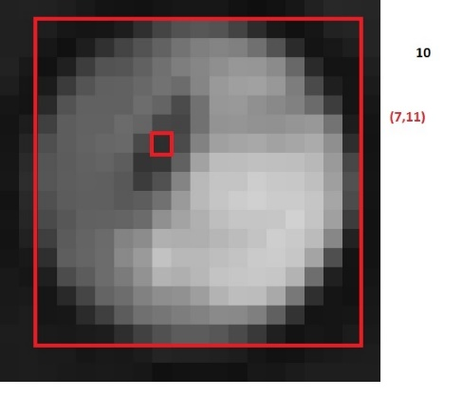
Manual Tracking
Each image is a consecutive frame of the same fly. I selected a pixel at center of the fly (marked in red) in each frame and calculated the distance between centers from one frame to the next.
1 2 3 4
(10,2)
(8,2)
(11,7)
(10,9)
5 6 7
Frame | X | Y | change
1 | 10 | 2 | n/a
2 | 8 | 2 | 2.0
3 | 11 | 7 | 5.8
4 | 10 | 9 | 2.2
5 | 11 | 10 | 1.4
6 | 11 | 7 | 3.0
7 | 6 | 5 | 5.4
8 | 7 | 10 | 5.1
9 | 7 | 11 | 1.0
10 | 7 | 11 | 0.0
(11,10)
(11,7)
(6,5)
8 9 10
(7,10)
(7,11)
(7,11)

Slide 3
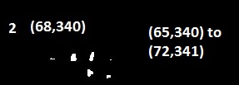
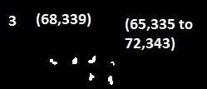
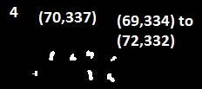
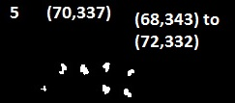
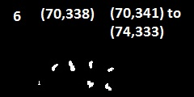
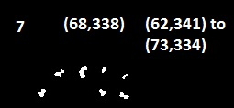
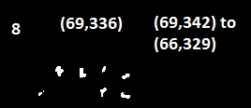
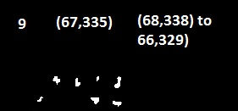
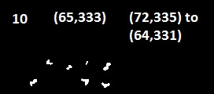
Semi Manual Tracking
These images from Acquire are the difference between two consecutive frames. Each white blob shows the change in location of one fly. The blobs in the red boxes are the same fly as shown in the previous slide, and were used for my calculations. To calculate distance travelled I used “Paint” to collect coordinates for the two most separated points in the blob and calculated the distances between those two points. Dividing by two accounts for the blobs identifying both where the fly was in the first frame and where it is in the second frame.
Frame | length
1 | Blank
2 | 3.5
3 | 5.3
4 | 1.8
5 | 5.9
6 | 4.5
7 | 6.5
8 | 6.7
9 | 4.6
10 | 4.5

Slide 4
Distance Calculations
Frame | 2 | 3 | 4 | 5 | 6 | 7 | 8 | 9 | 10
CalculateDistances (Acquire Output) | 8* | 3 | 0 | 2 | 0 | 0 | 0 | 0 | 0
AddFlyCoords | 17.0* | 7.6 | 4.1 | 5.1 | 4.5 | 1 | 1 | 0 | 0
AddFlyCoords/2 ** | 8.5* | 3.8 | 2.1 | 2.5 | 2.2 | 0.5 | 0.5 | 0 | 0
Manual (px) | 2.0 | 5.8 | 2.2 | 1.4 | 3.0 | 5.3 | 5.1 | 1 | 0
Semi Manual (px) | 3.5 | 5.3 | 1.8 | 5.9 | 4.5 | 6.5 | 6.7 | 4.6 | 4.5
* Acquire assumes the fly is at (0,0) in the first frame.
** Dividing the alternate calculation by two, and selecting a minimum threshold of 2.25 generates the same results that are output by Acquire.

